Slide 1
Introduction to Statistical Concepts
Session 4
Sema Barlas

Slide 2
What Test to Use?
Are the student final exam scores in classroom A significantly different from the average of 80% ?
Is there a significant difference in the mean height between the Eastern and Western Conference National Basketball League players?
Is there a significant difference in depression symptoms measured before and after attending a 10-week group therapy program?
It took 10 minutes and 5 seconds for Hal to run a mile last week when it was sunny but windy. Hal wants to compare his time to his friend’s running time of 9 minutes and 45 seconds, completed in perfect conditions. The day Hal ran, the mean time was 10 minutes and 50 seconds with a standard deviation of 15 seconds. The day his friend ran, the mean time was 10 minutes and 10 seconds with a standard deviation of 10 seconds. Who had the higher percentile score?
Are students in MSCA getting significantly less sleep than the recommended 8 hours?
Is there a significant difference between first year post college incomes of graduates from public versus private institutions?
Did student SAT scores increase significantly after attending a SAT prep course?
The GRE Verbal section mean = 500 and standard deviation = 113; Math section mean = 525 and standard deviation = 135. Class average scores are 600 on Verbal and 680 on Math: Which GRE section did the class do best on when comparing to others who took the same test?

Slide 3
Regression and ANOVA
Does SAT score predict GPA at the end of Freshman year in college?
Is there a relationship between years of education and income?
Is there a difference in computer proficiency skills for employees who are under 35, between 35-49 and 50 and over?
What are the effects of daily amount of TV viewing (<1 hour; 1-2 hours, >2 hours) on reading comprehension scores for elementary school children (first, second and third grade)?

Slide 4

Does Age of Clock Predict its Price?
Price’ = a + $b_{1}$*Age + $b_{2}∗Bidder$

Slide 5
Relationship Between Price and Age of Clocks
(price – price’)
Slope -> b
a
Price’ = a + b*Age
Notes:
pdf(file="Relationship Between Price and Age of clocks.pdf",
width = 5, height = 5)
reg1 <- lm(price~age)
par(cex=.8)
plot(age, price)
abline(reg1)
abline(h=mean(price))
abline(v=mean(age))
dev.off()

Slide 6
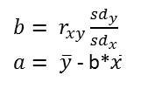
Does Age of Clock Predict its Price?
$b= r_{xy}\frac{{sd}_{y}}{{sd}_{x}}$
$a= \overline{y}$ - b*$\overline{x}$
Price’ = a + b*Age

Slide 7
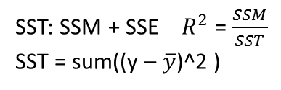
Does Age of Clock Predict its Price?
$b= r_{xy}\frac{{sd}_{y}}{{sd}_{x}}$
$a= \overline{y}$ - b*$\overline{x}$
Source | SS | df | MS | F | p
Model | 2554859 | 1 | 2554859 | 34.27 | .000
Error | 2236335 | 30 | 74544.5
Total | 4791194 | 31 | 154554.6
SST: SSM + SSE $R^{2}$ = $\frac{SSM}{SST}$
SST = sum((y – $\overline{y}$)^2 )
Notes:
SSM=sum((y’ - $\overline{y}$)^2)
SSE = sum((y – y’)^2)

Slide 8
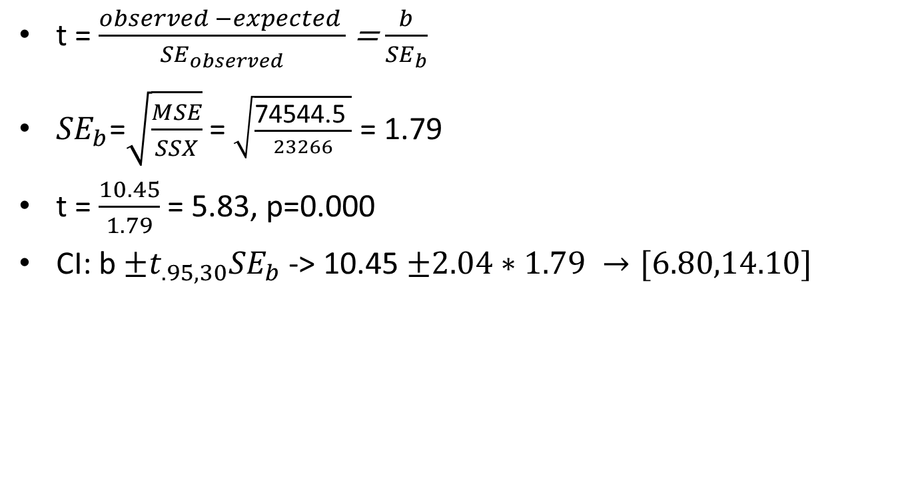
Significance Test
t = $\frac{observed −expected }{{SE}_{observed}}$ = $\frac{b}{{SE}_{b}}$
${SE}_{b}$=$\sqrt{\frac{MSE}{SSX}}$ = $\sqrt{\frac{\text{74544.5 }}{23266}}$ = 1.79
t = $\frac{10.45}{1.79}$ = 5.83, p=0.000
CI: b $±t_{.95,30}{SE}_{b}$ -> 10.45 $±2.04∗1.79 →[6.80,14.10]$
HO: β = 0
H1: β ≠ 0

Slide 9
Assumptions
Linearity
Homoscedasticity
Error distribution is normal.

Slide 10
Error Distribution
Notes:
fit = lm(price ~ age)
sresid = studres(fit)
pdf(file="Distribution of Error.pdf",
width = 5, height = 5) hist(sresid, freq=FALSE, main="Distribution of Studentized Residuals") xfit<-seq(min(sresid),max(sresid),length=40) yfit<-dnorm(xfit) lines(xfit, yfit)
dev.off()

Slide 11
Q-Q Plot
Notes:
pdf(file="Regression Diagnostics.pdf",
width = 5, height = 5)
qqPlot(fit, main="QQ Plot")
dev.off()

Slide 12
Influence Plot
Notes:
pdf(file="Influence Plot.pdf",
width = 5, height = 5)
influencePlot(fit, id.method=age, main="Influence Plot", sub="Circle size is proportional to Cook's Distance" )
dev.off()

Slide 13
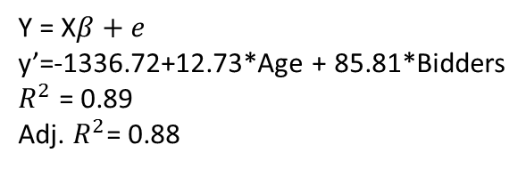
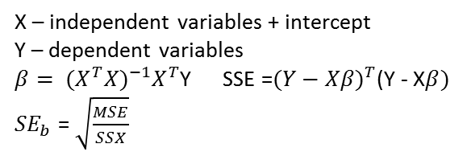
Multiple Regression
Y = X$β+e$
y’=-1336.72+12.73*Age + 85.81*Bidders
$R^{2}$ = 0.89
Adj. $R^{2}$= 0.88
Source | SS | df | MS | F | p
Model | 4277160 | 2 | 2138580 | 120.7 | .000
Age | 2554859 | 1 | 2554859 | 144.14 | .000
Bidders | 1722301 | 1 | 1722301 | 97.17 | .000
Error | 514035 | 29 | 17725
Total | 4791194 | 31 | 154554.6
Source | Estimate | SE | t | p
Intercept | -1336.72 | 173.3561 | -7.71 | .000
Age | 12.74 | 0.90 | 14.11 | .000
Bidders | 85.81 | 8.70 | 9.86 | .000
X – independent variables + intercept
Y – dependent variables
$β= {(X^{T}X)}^{−1}X^{T}$Y SSE =${(Y−Xβ)}^{T}$(Y - X$β)$
${SE}_{b}$ = $\sqrt{\frac{MSE}{SSX}}$

